Slide 1
Software Engineering
Wei-Min Wu（吴为民）
School of Petroleum
China University of Petroleum - Beijing at Karamay
Fall, 2025

Slide 2
Chap. 9 Software Evolution
Topics covered
Evolution processes 演化过程
Legacy systems 遗留系统
Software maintenance 软件维护

Slide 3
Chap. 9 Software Evolution
Software change 软件变更
During their lifetime, operational software systems have to change if they are to remain useful. 必须变更
Business changes and changes to user expectations generate new requirements for the software. 业务变化和用户期望的改变，产生了新需求
Parts of the software may have to be modified to correct errors that are found in operation, to adapt it for changes to its hardware and software platform, and to improve its performance or other non-functional characteristics. 修改软件，为了:修正错误,适应硬/软件平台的变化,改进性能或其他非功能特性
Software products and apps have to evolve to cope with platform changes and new features introduced by their competitors. 应对平台变化和竞争者引入的新特征

Slide 4
Chap. 9 Software Evolution
Importance of evolution 演化的重要性
Businesses have to change their software to ensure that they continue to get value from it. Their systems are critical business assets, and they have to invest in change to maintain the value of these assets. Consequently, most large companies spend more on maintaining existing systems than on new systems development. 持续获得价值
Software evolution is particularly expensive in enterprise systems when individual software systems are part of a broader “system of systems.” You cannot just consider the changes to one system; you also need to examine how the changes affect the broader system of systems (brownfield systems). Changing one system may mean that other systems in its environment may also have to evolve to cope with that change. 棕地系统:演化尤其昂贵

Slide 5
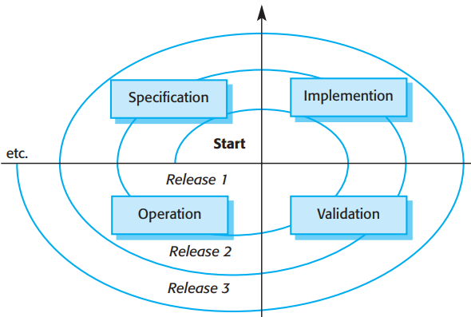

Chap. 9 Software Evolution
A spiral model of development and evolution
* New releases of the systems that incorporate changes and updates are usually created at regular intervals.
* Software engineering is therefore a spiral process with requirements, design, implementation, and testing going on throughout the lifetime of the system.
* You start by creating release 1 of system. Once delivered, changes are proposed, and the development of release 2 starts almost immediately. In fact, the need for evolution may become obvious even before the system is deployed, so later releases may start development before the current version has even been released.

Slide 6
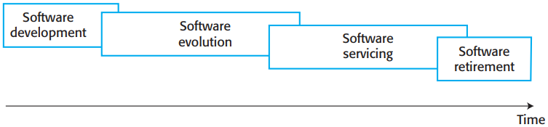

Chap. 9 Software Evolution
Evolution and servicing 演化和维修
In an alternative view of the software evolution life cycle for business systems, the distinguish between evolution and servicing was made. Evolution is the phase in which significant changes to the software architecture and functionality are made. During servicing, the only changes that are made are relatively small but essential changes. These phases overlap with each other, as shown in Figure 9.2. 另一个视图:区别演化和维修

Slide 7
Chap. 9 Software Evolution
9.1 Evolution processes 演化过程
The most appropriate evolution process for a software system depends on: the type of software being maintained, the software development processes used, and the skills of the people involved. 演化过程取决于软件类型、开发过程、人员技能
Formal or informal system change proposals are the driver for system evolution. In a change proposal, an individual or group suggests changes and updates to an existing software system. These proposals may be based on existing requirements that have not been implemented in the released system, requests for new requirements, bug reports from system stakeholders, and new ideas for software improvement from the system development team. 正式和非正式变更建议是系统演化的驱动力

Slide 8
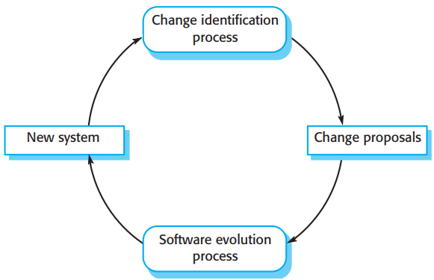

Chap. 9 Software Evolution
Change identification and evolution processes变更识别和演化过程
* The processes of change identification and system evolution are cyclical and continue throughout the lifetime of a system (Figure 9.3).
* Before a change proposal is accepted, there needs to be an analysis of the software to work out which components need to be changed.
* This analysis allows the cost and the impact of the change to be assessed.

Slide 9
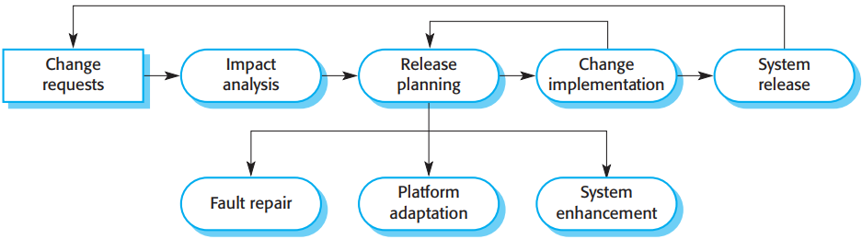

Chap. 9 Software Evolution
The software evolution process 软件演化过程
* Fig. 9.4 shows some of the activities involved in software evolution. The process includes the fundamental activities of change analysis, release planning, system implementation, and releasing a system to customers. The cost and impact of these changes are assessed to see how much of the system is affected by the change and how much it might cost to implement the change.
* If the proposed changes are accepted, a new release of the system is planned. During release planning, all proposed changes (fault repair, adaptation, and new functionality) are considered. A decision is then made on which changes to implement in the next version of the system. The changes are implemented and validated, and a new version of the system is released. The process then iterates with a new set of changes proposed for the next release.

Slide 10

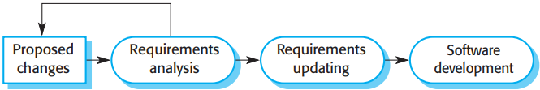
Chap. 9 Software Evolution
Change implementation 变更实现
* If requirements specification and design documents are available, these should be updated during the evolution process to reflect the changes that are required (Figure 9.5).
* New software requirements should be written, and these should be analyzed and validated. If the design has been documented using UML models, these models should be updated.
* The proposed changes may be prototyped as part of the change analysis process, where you assess the implications and costs of making the change.

Slide 11
Chap. 9 Software Evolution
9.2 Legacy systems 遗留系统
Legacy systems are older systems that rely on languages and technology that are no longer used for new systems development. 老系统,依赖于已不再使用的语言和技术
Typically, they have been maintained over a long period, and their structure may have been degraded by the changes made. 已维护很长时间,结构已退化
Legacy software may be dependent on older hardware, such as mainframe computers and may have associated legacy processes and procedures. 依赖于旧硬件
It may be impossible to change to more effective business processes because legacy software cannot be modified to support new processes. 无法变更为更有效的业务过程

Slide 12

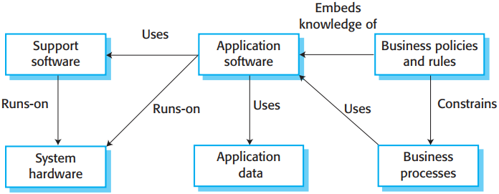
Chap. 9 Software Evolution
The elements of a legacy system
* Legacy systems are not just software systems but are broader sociotechnical systems that include hardware, software, libraries, and other supporting software and business processes.
* Fig. 9.7 shows the logical parts of a legacy system and their relationships.

Slide 13
Chap. 9 Software Evolution
Legacy system components 遗留系统的构件
System hardware: Legacy systems may have been written for hardware that is no longer available, that is expensive to maintain, and that may not be compatible with current organizational IT purchasing policies.系统硬件
Support software: The legacy system may rely on a range of support software from the operating system and utilities. Again, these may be obsolete and no longer supported by their original providers. 支持软件
Application software: The application system that provides the business services is usually made up of a number of application programs that have been developed at different times. 应用软件

Slide 14
Chap. 9 Software Evolution
Legacy system components cont’d
Application data: These data are processed by the application system. In many legacy systems, an immense volume of data has accumulated over the lifetime of the system. This data may be inconsistent, may be duplicated in several files, and may be spread over a number of different databases. 应用数据
Business processes: These processes are used in the business to achieve some business objective. Business processes may be designed around a legacy system and constrained by the functionality that it provides. 业务过程
Business policies and rules: These are definitions of how the business should be carried out and constraints on the business. Use of the legacy application system may be embedded in these policies and rules. 业务政策和规则

Slide 15

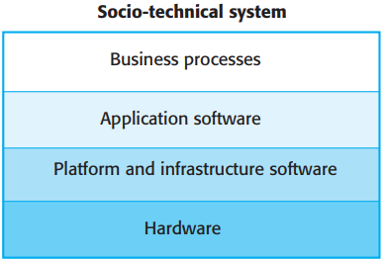
Chap. 9 Software Evolution
Legacy system layers 遗留系统层次
* An alternative way of looking at the components of a legacy system is as a series of layers, as shown in Figure. 9.8.
* Each layer depends on the layer immediately below it and interfaces with that layer. If interfaces are maintained, then you should be able to make changes within a layer without affecting either of the adjacent layers.
* In practice, however, this simple encapsulation is an oversimplification, and changes to one layer of the system may require consequent changes to layers that are both above and below the changed level.

Slide 16
Chap. 9 Software Evolution
Legacy system replacement 遗留系统替换
Why not simply replace legacy systems with more modern equivalents? The simple answer is: it is too expensive and risky. 为什么不简单代替? 太昂贵,有风险
The reasons why it is expensive and risky to replace legacy systems with new systems: 具体原因
There is rarely a complete specification of the legacy system. 遗留系统很少有完备的规格说明
Business processes and the ways in which legacy systems operate are often inextricably intertwined. 业务过程与遗留系统的运行方式不可避免地纠缠在一起
Important business rules may be embedded in the software and may not be documented elsewhere. 重要的业务规则可能嵌入在软件中,没有在别处文档化
New software development is inherently risky, so that there may be unexpected problems with a new system. 新软件开发有内在风险,新系统会有无法预料的问题

Slide 17
Chap. 9 Software Evolution
Legacy system change 遗留系统变更
Keeping legacy systems in use avoids the risks of replacement, but making changes to existing software inevitably becomes more expensive as systems get older. 保持使用遗留系统避免了替换的风险,但随着系统老化,变更变得更加昂贵
Legacy systems are particularly expensive to change for several reasons: 变更昂贵的原因
The program style and usage conventions are inconsistent because different people have been responsible for system changes. 程序风格和用法习惯不同
Part or all of the system may be implemented using obsolete programming languages. It may be difficult to find people who know these languages. 编程语言过时

Slide 18
Chap. 9 Software Evolution
Legacy system change 遗留系统变更
Legacy systems are particularly expensive to change for several reasons: 变更昂贵的原因（续）
System documentation is often inadequate and out of date. 系统文档常常不充分和过时
Many years of maintenance usually degrades the system structure, making it increasingly difficult to understand. 多年维护通常使系统体系结构退化,越来越难理解
The system may have been optimized for space or speed, which usually lead to software that is hard to understand. 系统已针对空间/时间做了优化,导致难以理解
The data may be maintained in different files that have incompatible structures. There may be data duplication, and the data may be out of date, inaccurate, and incomplete. 数据问题:结构不兼容、重复、过时、不准确、不完备

Slide 19
Chap. 9 Software Evolution
9.3 Software maintenance 软件维护
Software maintenance is the general process of changing a system after it has been delivered. 含义：系统交付后,对其变更的一般过程
The term is usually applied to custom software, where separate development groups are involved before and after delivery. 通常针对定制软件,交付前后涉及不同的开发小组
The changes may be simple changes to correct coding errors, more extensive changes to correct design errors, or significant enhancements to correct specification errors or to accommodate new requirements. 各种变更
Changes are implemented by modifying existing system components and, where necessary, by adding new components to system. 实施:修改现有构件,必要时加入新构件

Slide 20
Chap. 9 Software Evolution
Types of maintenance: 3 types 3种维护类型
Fault repairs to fix bugs and vulnerabilities. Coding errors are usually relatively cheap to correct; design errors are more expensive. Requirements errors are the most expensive to repair. 故障修理: 修复故障和弱点
Environmental adaptation to adapt the software to new platforms and environments. This is required when some aspect of a system’s environment, such as the hardware, the platform operating system, or other support software, changes. 环境适应: 使软件适应新平台和环境
Functionality addition to add new features and to support new requirements. This is necessary when system requirements change in response to organizational or business change. The scale of changes is often much greater. 功能加入: 加入新的特征,支持新需求

Slide 21
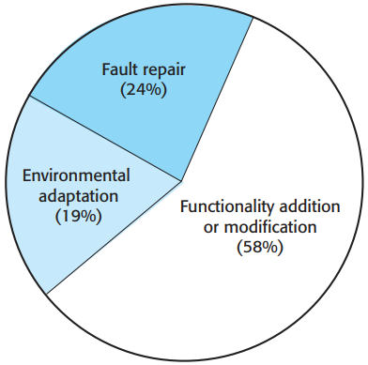

Chap. 9 Software Evolution
Maintenance effort distribution 维护工作量分布
* Fig. 9.12 shows an approximate distribution of maintenance costs, based on data from the most recent survey available.
* The authors found that the distribution of maintenance costs had changed very little over 30 years. Although we don’t have more recent data, this suggests that this distribution is still largely correct.
* Repairing system faults is not the most expensive maintenance activity. Evolving the system to cope with new environments and new or changed requirements generally consumes most maintenance effort.

Slide 22
Chap. 9 Software Evolution
Maintenance costs 维护成本
It is usually more expensive to add new features to a system during maintenance than it is to implement the same features during initial development. 在维护期间加入新特征,相比在初始开发时实现相同特征,通常更加昂贵
The reasons for this are: 原因
A new team has to understand the program being maintained. 新团队必须理解要维护的程序
Separating maintenance and development means there is no incentive for the development team to write maintainable software. 开发团队没有编写维护代码的动机
Program maintenance work is unpopular. 程序维护工作不受欢迎
As programs age, their structure degrades and they become harder to change. 时间变化,程序退化,更难变更

